Slide 1
Sales Analysis and Recommendations
Key Findings and Strategic Insights (2023-2024)

Slide 2
Monthly and Yearly Sales Growth
- Total revenue for 2023: $77.7M
- Total revenue for 2024: $73.9M
- Monthly trends show peaks in March and April.
- Seasonal variations influence performance.

Slide 3
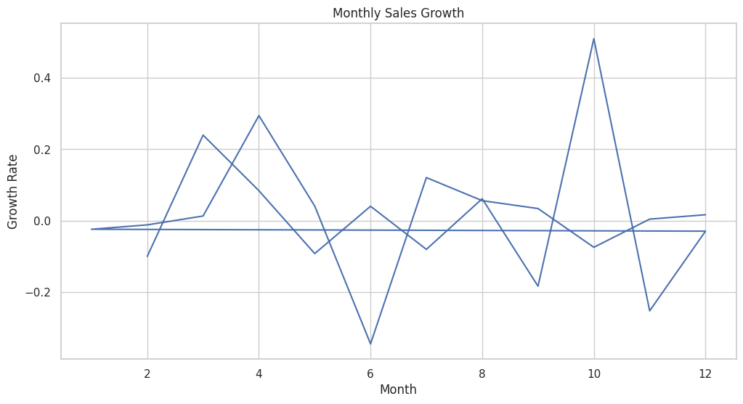

Slide 4
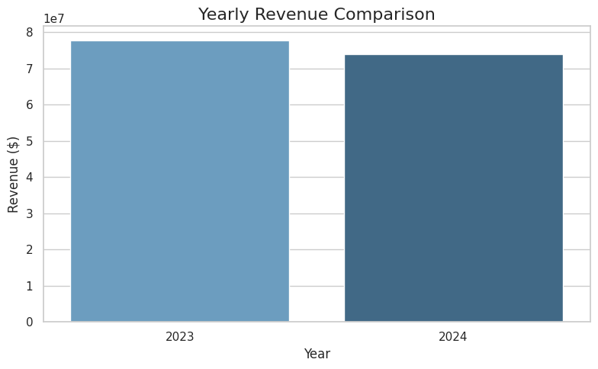

Slide 5
Best-Performing Categories and Products
Top Categories by Revenue:
1. Electronics: $24.1M
2. Books: $23.5M
3. Toys: $22.3M
Top Products by Revenue:
1. Board Game: $5.75M
2. Laptop: $5.69M
3. Football: $5.08M

Slide 6
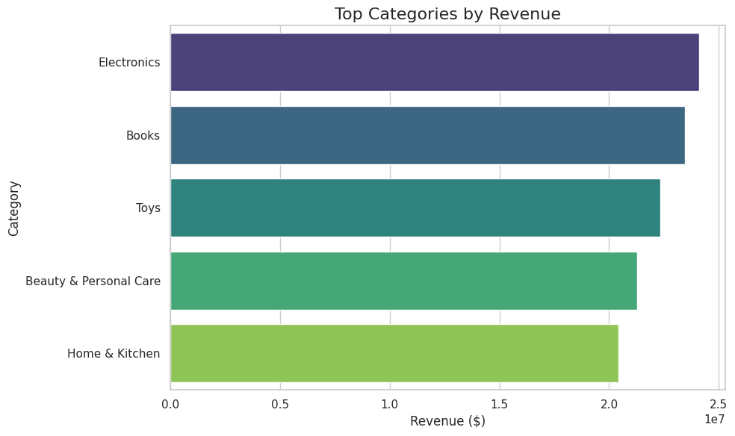

Slide 7
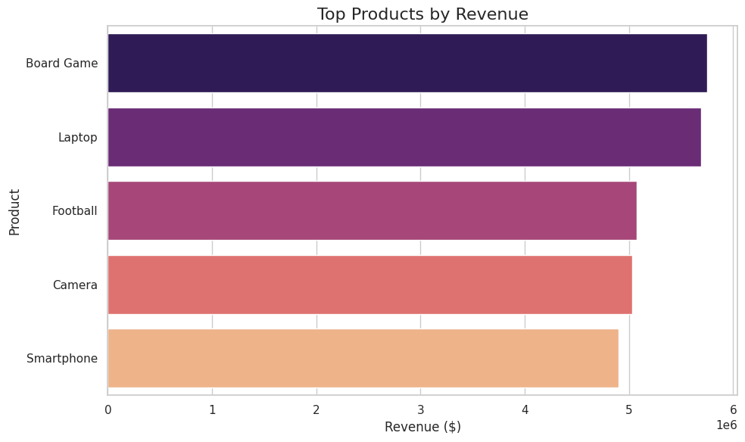

Slide 8
Seasonal Trends and Impact
- Winter and Fall show high sales for Toys and Electronics.
- Spring and Summer focus on outdoor products like Footballs.
- Holidays drive revenue spikes in Q4.

Slide 9
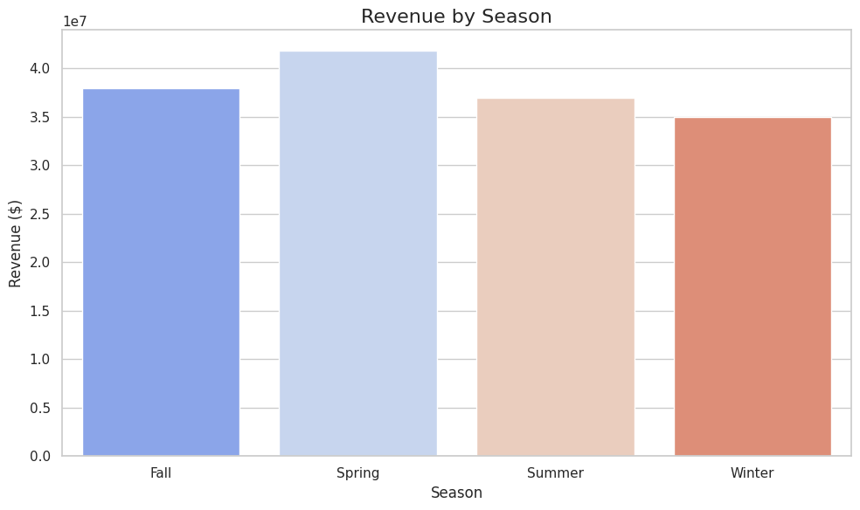

Slide 10
Recommendations to Improve Sales Performance
1. Focus on top-performing categories (Electronics, Books).
2. Use seasonal promotions to boost sales in Winter and Fall.
3. Enhance marketing for best-selling products (Board Game, Laptop).
4. Retarget underperforming products with pricing strategies.

Slide 11
5. Introduce loyalty programs to retain customers.
6. Leverage data analytics to forecast demand and optimize inventory.

